Slide 1

Developing a Package in R to Test Sports Momentum
Julie Abaci
Dr. John Ruscio

Slide 2
Introduction
Sports momentum: “The positive or negative change in cognition, affect, physiology, and behavior caused by an event or series of events that affects either the perceptions of the competitors or, perhaps, the quality of performance and the outcome of the competition.”¹
E.g. “Hot Hand”
Largely falsified²
Fallacy can be attributed to cognitive errors³
Requires a specific, replicable protocol for statistical testing
Ruscio & Brady (2020) → Five tests for momentum
¹ Kent, 2006 (p. 444)
² Avugos et al. (2013)
³ Tversky & Kahneman (1974)
Notes:
Meta analysis by Avugos et al. (2013) looked at 30 studies from 1985-2012, found a minor and insignificant mean effect size

Slide 3
Runs Test
Involves the number of runs (streaks) within a given sequence
W = Win L = Loss
Momentum Hypothesis: the number of runs will be smaller than expected by chance
Null Hypothesis: the number of runs will match chance-level expectations
Randomized sequence:
WWLLLWLWWLWWLWLLWWLL
Streaky Sequence:
WWWWWWWWWWLLLLLLLLLL
1 2 3 4 5 6 7 8 9 10 11 12
1 2

Slide 4
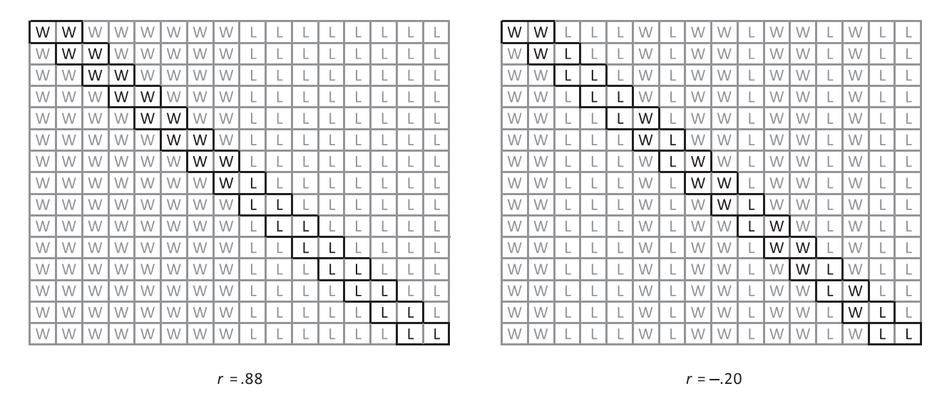
Autocorrelation
Examines the sequential dependence of outcomes (whether wins predict wins and losses predict losses in back-to-back games)
WWLLLWLWWLWWLWLL WWWWWWWWLLLLLLLL
Momentum Hypothesis: autocorrelations will be larger than expected by chance
Null Hypothesis: autocorrelations will match chance level expectations.
Ruscio & Brady (2020)
Notes:
Clarify that the left is more streaky, so the correlation coefficient is higher, as wins tend to be followed by wins and losses by losses
Right is less streaky, so the correlation coefficient is lower

Slide 5
Conditional Probabilities
Examines whether previous outcomes exert influence on the probability of the subsequent outcomes
p(W | LLL) p(W | LL) p(W| L) p(W) p(W | W) p(W | WW) p(W | WWW)
Momentum Hypothesis: probabilities for an outcome will be significantly different from chance-level probabilities (upward slope)
Null Hypothesis: probabilities will match chance-level probabilities (flat)
Probability of a win regardless of sequence
Probability of a win given a sequence of three losses
Probability of a win given a sequence of three wins
Notes:
Slope upward

Slide 6
Code Development
streakTests <- function(data, succ = 1, fail = 0, n = 1000, conf = .95, dp = 3, pdp = 3,runsT = T, acT = T, lag = 1, cpT = T, prior = 3, graph = T)
data: binary data sequence or a matrix containing rows of binary data sequences
succ: numerical code for a "success" event
fail: numerical code for a "failure" event
n: number of bootstrap samples used to generate sampling distributions
conf: confidence level
dp: number of decimal places
pdp: number of decimal places for p values
runsT: whether to perform the runs test
acT: whether to perform the autocorrelation test
lag: lag for autocorrelations
cpT: whether to perform the conditional probabilities test
prior: number of prior events for conditional probabilities
graph: whether to provide visualization of results

Slide 7
Code Development
install.packages("devtools")
devtools::install_github("abacij/MyPackage", force = TRUE)
library(MomentumTest)
x0 <- rbinom(100, 1, .5) #random vector of 100, not streaky
x1 <- c(rbinom(25, 1, .85), rbinom(25, 1, .15), rbinom(25, 1, .85), rbinom(25, 1, .15)) #streaky

Slide 8

Code

Slide 9
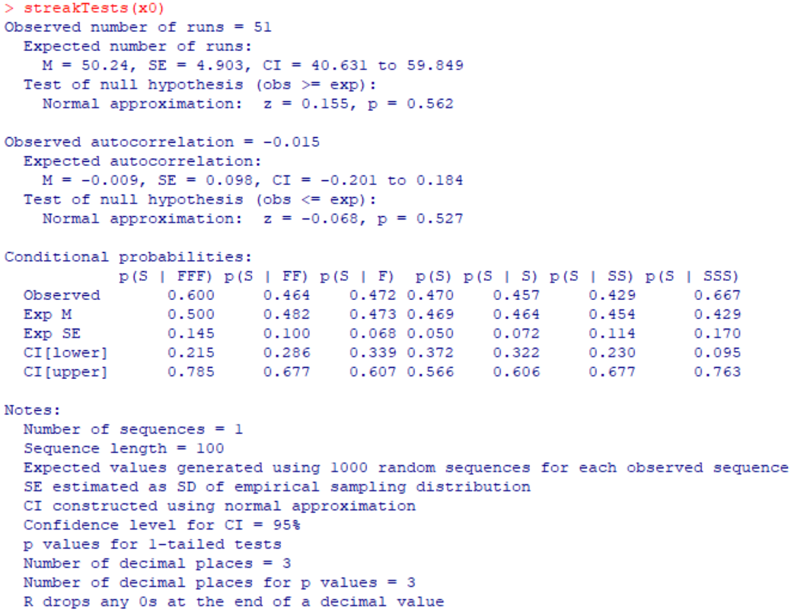
Random Sequence Output

Slide 10
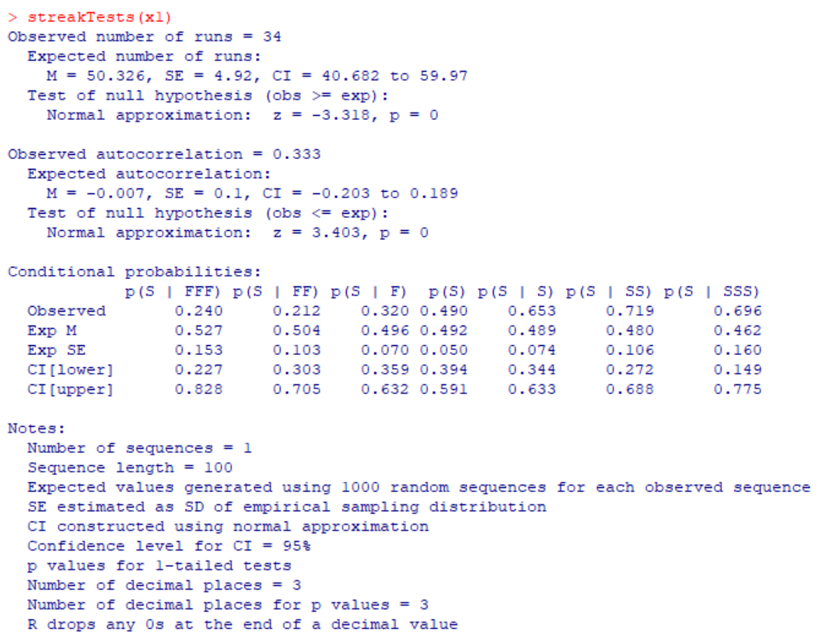
Streaky Sequence Output

Slide 11
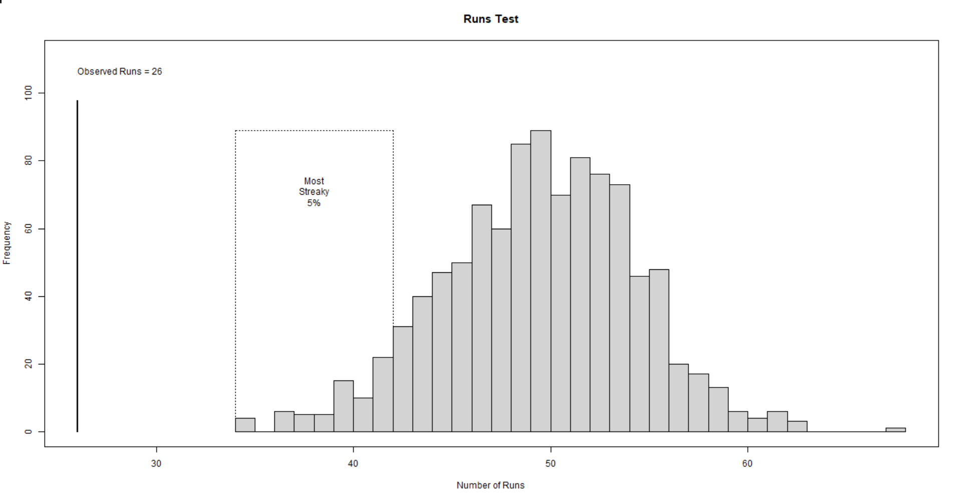
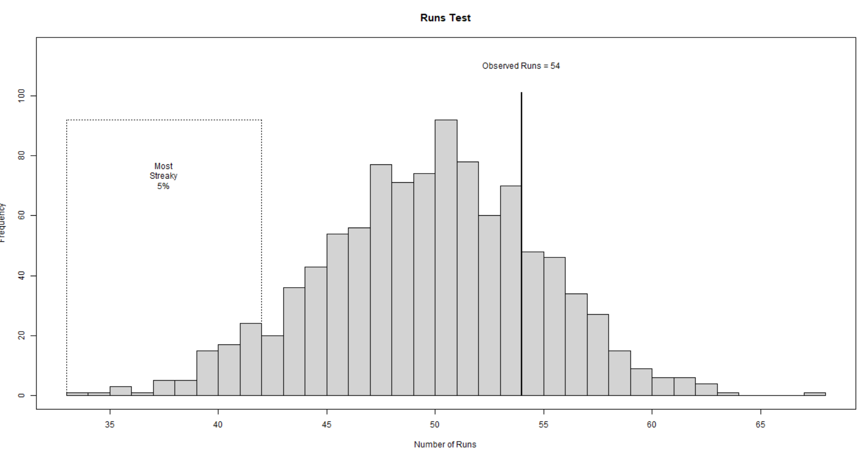
Runs Visuals
Random Vector
Streaky Vector

Slide 12
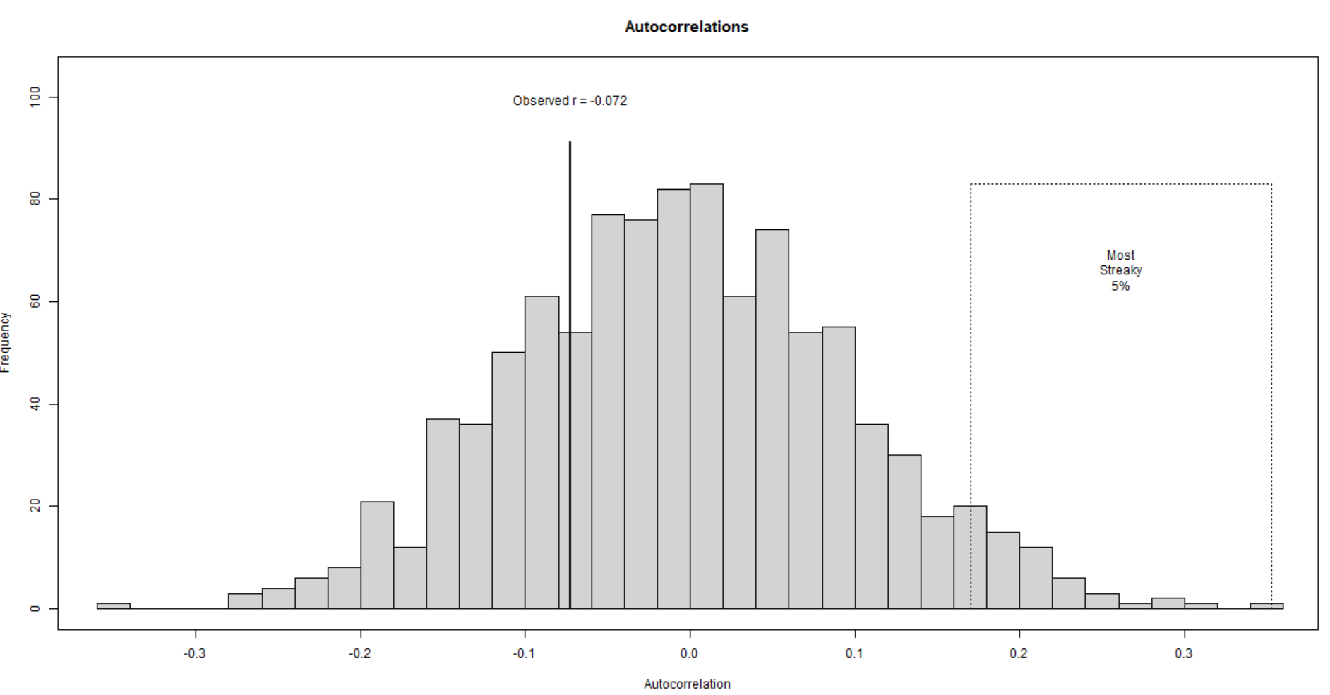
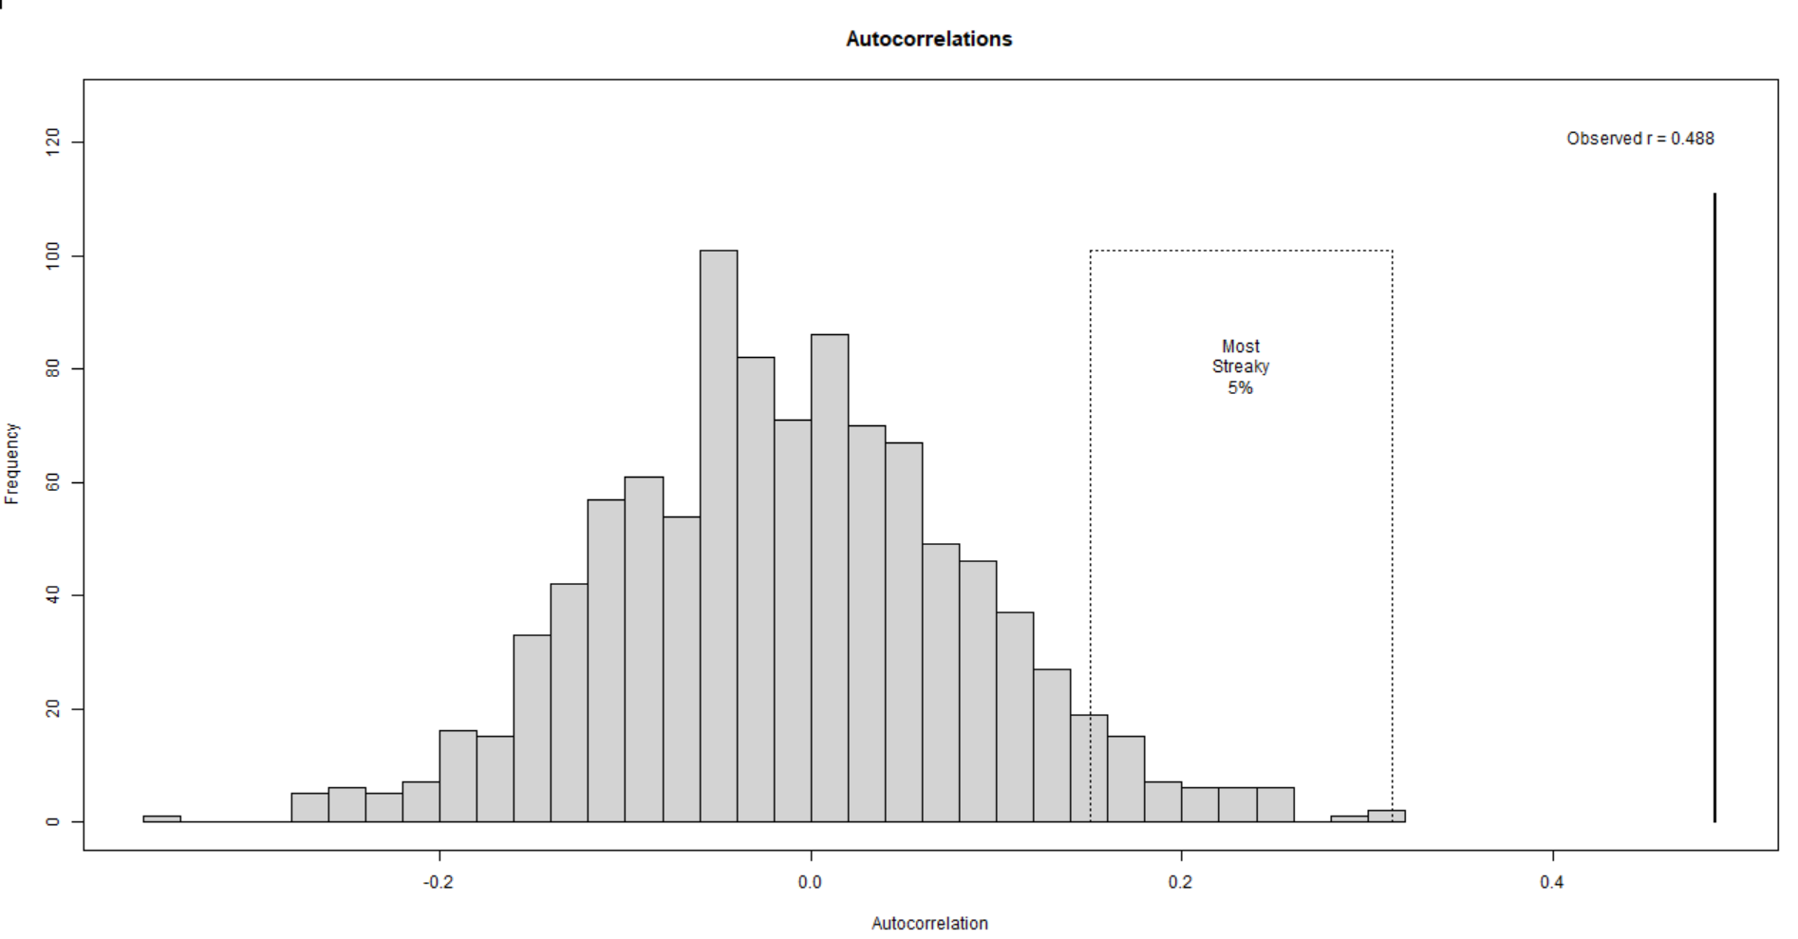
Autocorrelation Visuals
Random Vector
Streaky Vector

Slide 13
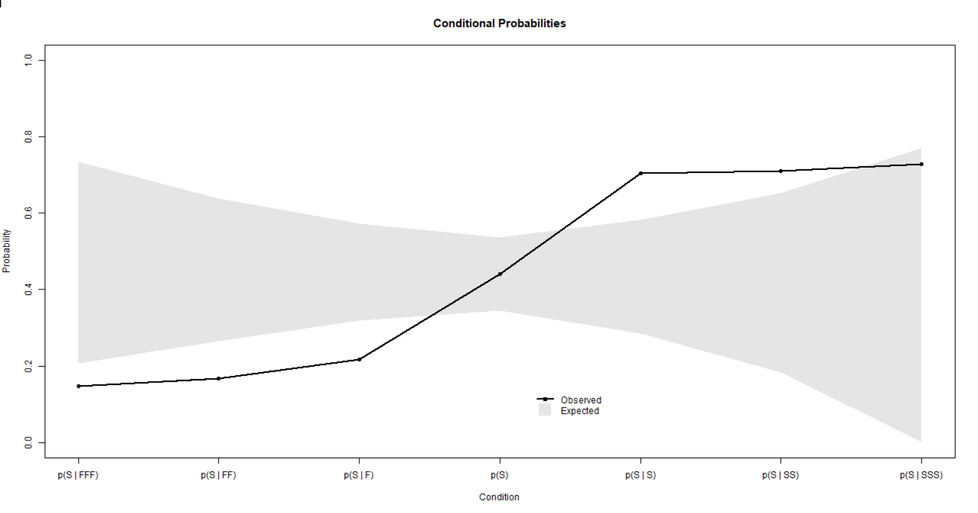
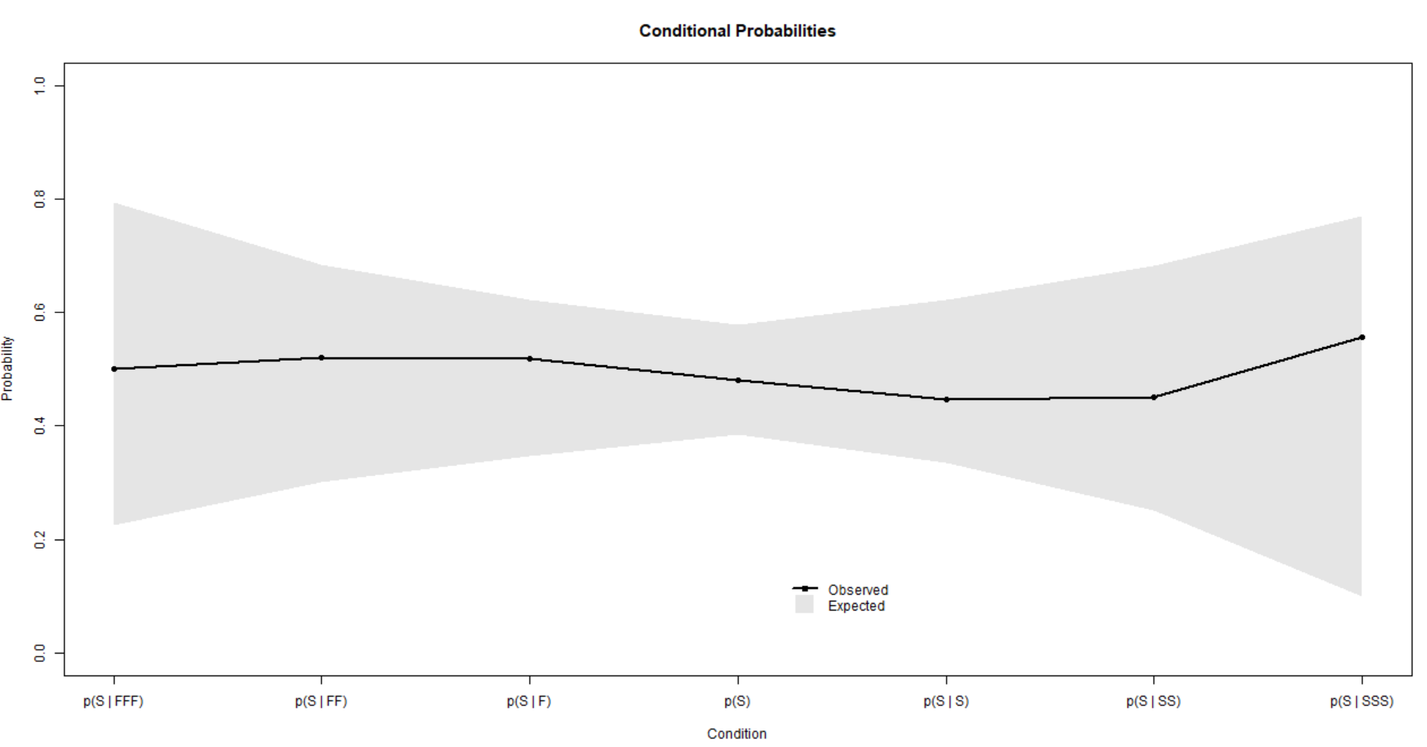
Conditional Probability Visuals
Random Vector
Streaky Vector

Slide 14
Thank you!
Find the package here: https://github.com/abacij/Momentum-Package
Please reach out with questions and thoughts!
Abacij1@tcnj.edu

